Slide 1
Introduction to CSS (Cascading Style Sheets)

Slide 2
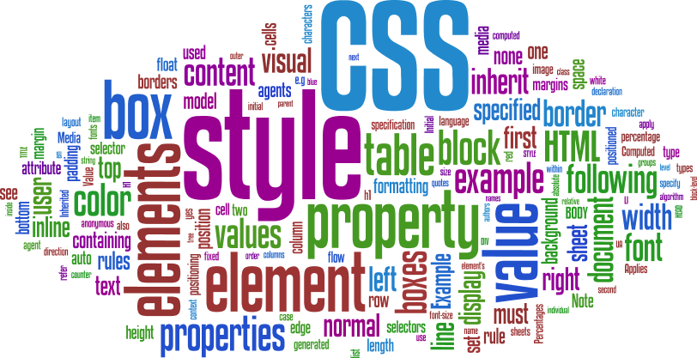
Beginning CSS
Introduction to Web Design and Development
CSCI 1710
(Adapted from notes created by Stephen Hendrix)

Slide 3

The Power of CSS
Notes:
All Zen Garden pages styled and positioned totally with CSS.

Slide 4

What is CSS?
Allow users to apply typographic and design styles for elements on a page
Done by using established HTML elements and specifying a rule for how that element should be displayed
Creates rules that specify how the content of an element should appear
Once you have learned how to write a CSS rule, learning CSS mostly involves learning the different properties you can use
W3Schools is an excellent resource for this
Notes:
Rule Definition and Placement

Slide 5
Advantages
Greater page layout and style controls
Size, color, line spacing, placement, margins, etc.
Separates style from structure in the HTML document
Easier site maintenance
Make style changes to many pages (entire site) at once

Slide 6
Disadvantages
CSS not uniformly implemented in browsers
Older browsers don't support. Newer browsers have variances in display
Different versions of CSS are implemented (CSS2 vs CSS3)
HTML5 became standard on October 28, 2014 (hence all the reworking of lecture notes)

Slide 7
Versions
CSS 1 (1996) - No longer maintained
CSS 2 (1998) - No longer maintained
CSS 2.1 (2011) - Planned as the first & final revision of level 2, but work on CSS 2.2 began in 2015. This is the current “official” standard
CSS 3 (2012 - 2021) - Things got a lot more complicated here. CSS 3 is broken down into several distinct “modules,” which are in varying stages of development. Still hasn’t been “officially” adopted as the standard, though modern browsers mostly support it. (* big topic in CSCI 1720)
CSS 4 (?) - Proposed updates to CSS 3. Again, split into modules. It seems unlikely at this point if there will ever be a single, CSS 4 standard

Slide 8

The Power of CSS
HTML defines structure
CSS defines style
Separating the two concerns makes each easier to write and maintain
Back in the day, what would have been
…and would have to be applied to each <h1> in the document

Slide 9

The Power of CSS
HTML defines structure
CSS defines style
Separating the two concerns makes each easier to write and maintain
Is now
…and can now be applied to all <h1> elements at a time

Slide 10
Ways to Define Styles
One or more rules
contained in an external style sheet (linked)
contained in an internal style sheet (embedded)
applied directly to a tag (inline)

Slide 11
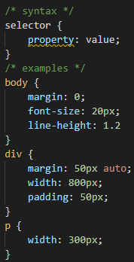
Ways to Define Styles
Style sheet rule syntax
Property/value pairs separated by semicolon

Slide 12
External Style Sheets
One way we can implement CSS is through external (linked) style sheets
With external style sheets we create a second document and name it with a .css extension, e.g., style.css
This second file contains only the CSS expressions
Preferred method for employing CSS
External stylesheets allow for modifying style across multiple HTML documents from a single location

Slide 13
External Style Sheets
Within every page that needs to use the external style sheet, we add the following tag to the head section of the document:
The advantage to external style sheets is that we can create one (or several) css file(s) and our entire website can use it/them

Slide 14
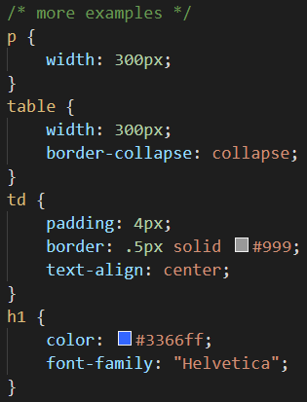
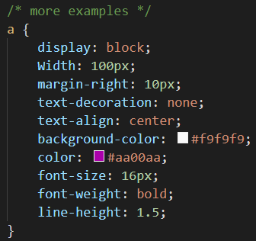
External Style Sheets

Slide 15
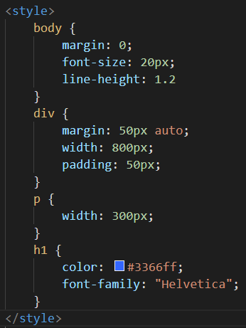
Embedded Style Sheets
Embedded style sheets are defined in the <head> section of the document
Only apply to the page in which they’re included
Embedded style sheets are used to apply style to a single web page

Slide 16
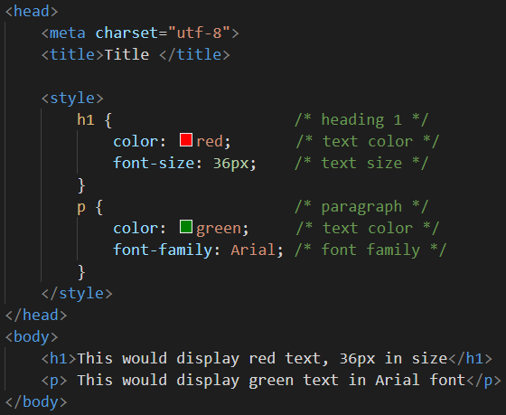
Embedded Style Sheets

Slide 17

Embedded Style Sheets

Slide 18
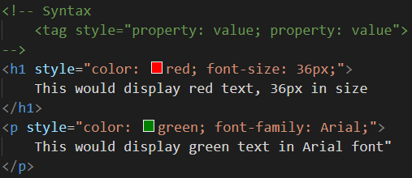
Inline Style
Option three is declaring CSS inline
Inline allows us to add CSS to one specific tag within a document

Slide 19
Inline Style

Slide 20
Order of Operations

Slide 21
Order of Operation
What happens if more than one style is applied to the same property for a tag?
The more specific rule is applied
In order of highest priority to lowest priority, we would have:
Inline style
Embedded style
Linked Style
Browser default

Slide 22
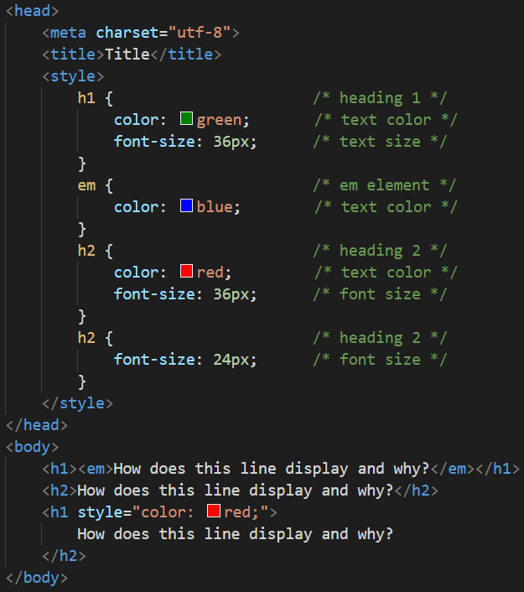


Slide 23
Order of Operation
What happens if more than one property’s value is applied to an element using different forms of CSS (External, Embedded, or Inline)?
The more recent the definition has the higher priority (i.e., the rule that is closest to the element in the HTML that it affects)
Let’s say in the below example, style.css has a rule that changes all paragraphs to a background color of blue

Slide 24
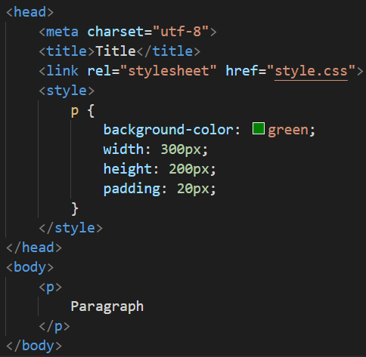
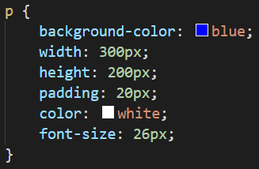
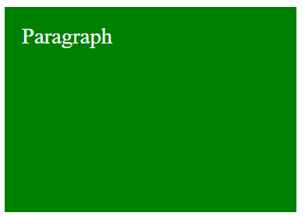
Order of Operation
style.css
index.html

Slide 25
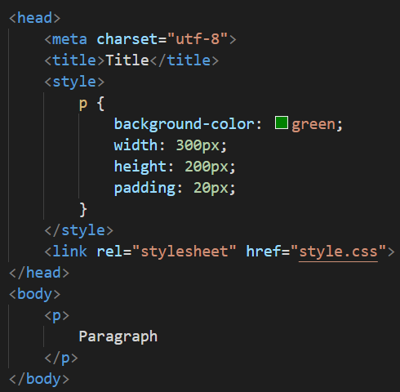
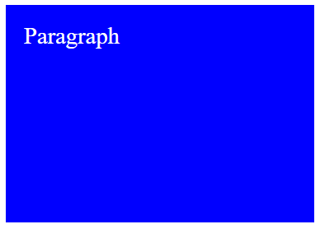
Order of Operation
style.css
index.html

Slide 26
Commenting

Slide 27
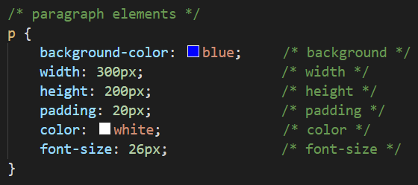
Commenting
In CSS, we can apply comments to embedded and linked CSS
To place a comment we use the syntax -- /* COMMENT */
Generally, you don’t have to be this detailed with your comments (this is mostly for illustration)
But comments should be included in your code to explain what’s going on
You might not be the person who has to update it later!

Slide 28
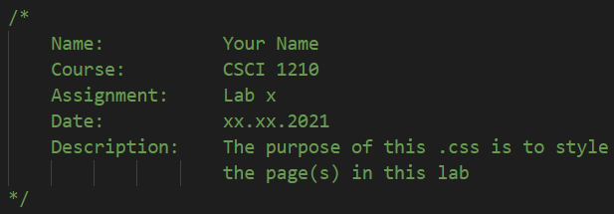
Commenting
For all .css files created, you must have the following comment block:

Slide 29
IDs & Classes

Slide 30
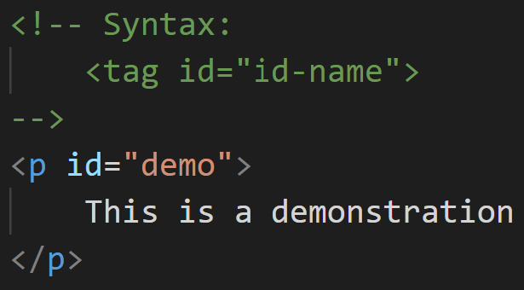
ID Attribute
Every element on a web page can be assigned a unique ID so that it can be identified by other applications such as CSS or Javascript
A given ID can appear only once on a given page
Value should start with a letter or an underscore (_), not a number or any other character

Slide 31
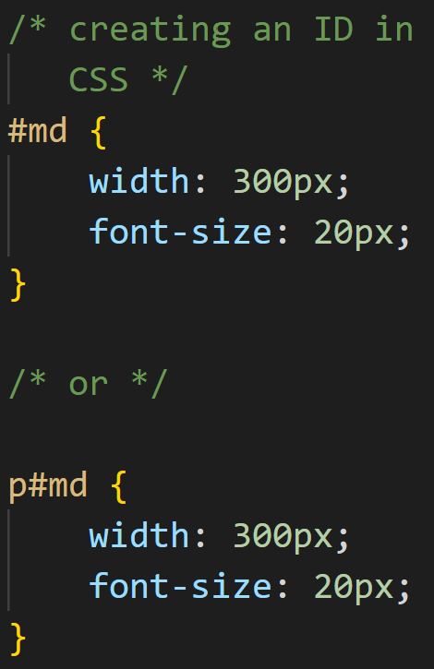
ID Attribute
Since an ID is unique to a page, this is how we usually reference it in CSS
The octothorpe (“#”) will apply the CSS rules to that element only
The second example is valid, but it isn’t necessary to include the element name (see above)

Slide 32
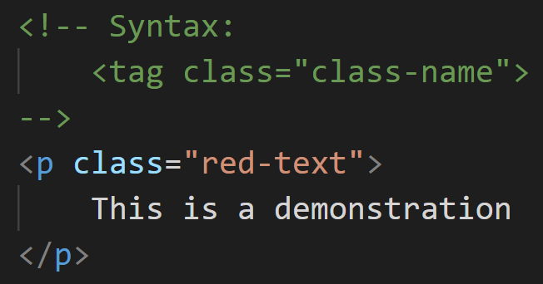
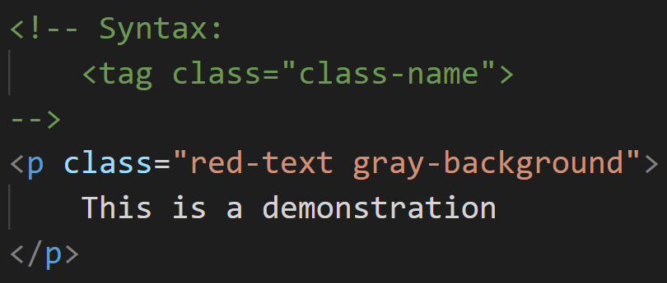
Class Attribute
Every element on a web page can also have one or more class attributes
Classes can be assigned to multiple elements on a page
Value must start with a letter or an underscore (_), not a number or any other character
Can assign multiple classes to an element, separated by spaces

Slide 33
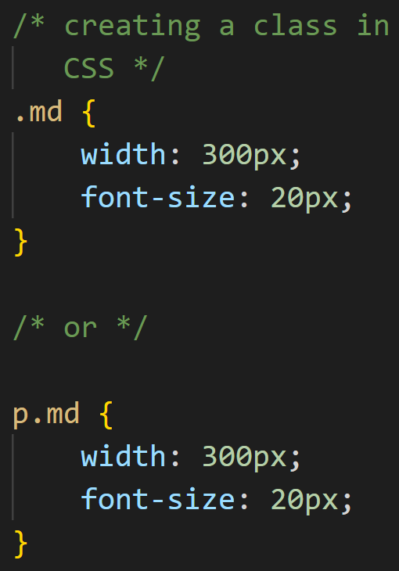
Class Attribute
Again, classes can be used to modify an element’s presentation, in multiple elements on a given page. These are the building-blocks used by CSS frameworks
To create a class, we use a dot (“.”)

Slide 34
Class Attribute
Will be applied to any element that includes this class
More generic

Slide 35
Class Attribute
Will be applied only to paragraph elements
More specific

Slide 36
CSS Text Properties

Slide 37
CSS Text Properties
text-align: (left, right, center, justified) -- p{text-align:center;}
text-indent: (pixels or percentage) -- p{text-indent: 5%;}
text-decoration: (none, overline, underline, line-through) -- p{text-decoration: underline;}
word-spacing: (pixels) -- p{word-spacing: 5px;}
letter-spacing: (pixels) -- p{letter-spacing: 5px;}

Slide 38
CSS Text Properties
line-height: (pixels, percentage, number) -- p{line-height: 2;} /* this is double space */
color: (name, hex, rgb, rgba) -- p{color: red;}
font-family: (specific,to,general) -- p{font-family:”Times New Roman”, Georgia, Serif;}

Slide 39
CSS Text Properties
font-size: (px, pt, em, or %) -- p{font-size: 10px;}
font-weight: (lighter, normal, bold, bolder, or value 100-900) --
p{font-weight:bold;}
font-style: (italic, oblique) -- p{font-style:italic;}

Slide 40
CSS Background
background-color: (name, hex, rgb, rgba) -- p{background-color: green;}
background-image: url(imageLocation relative or abs) -- p{background-image: url(“images/bg.jpg”);}
background-repeat: (no-repeat, repeat-x, repeat-y, repeat) -- p{background-repeat: no-repeat;}
background-size: (width and height in px or percent, or the word “cover”) -- p{background-size: cover;}

Slide 41
CSS Background
background-position: (left, right, center, top, bottom, center)
background-attachment: (fixed, scroll)
body{ background-image: url(“images/bg.gif”); background-repeat: no-repeat; background-size: 100% 100%; }

Slide 42
CSS Colors

Slide 43
Colors
Effective use of colors can make or break a site
CSS has a number of ways of defining color
Color keywords (“red,” “green,” “blue,” etc.)
RGB (Red, Green, Blue)
Hexadecimal
RGBa (Red, Green, Blue, Alpha)
HSL (Hue, Saturation, Luminosity)
HSLa (Hue, Saturation, Luminosity, Alpha)
We’ll look at the first four

Slide 44

Colors
Option 1 - named colors
One option is to use the named color keywords.
There are 17 standard colors
aqua, black, blue, fuchsia, gray, green, lime, maroon, navy, olive, orange, purple, red, silver, teal, white, and yellow
There are 128 additional colors
BlanchedAlmond, ForestGreen, HoneyDew, WhiteSmoke, RebeccaPurple

Slide 45
Colors
Purple was the favorite color of Rebecca Alison Meyer who passed away twelve hours into her sixth birthday from brain cancer. Rebecca was the daughter of prolific CSS standards pioneer Eric Meyer. Eric kept his online colleagues informed of the battle his daughter and family were waging through blog posts and brief updates on Twitter.
After hearing the awful news, designer/author Jeffrey Zeldman decided to do something and started a Twitter hashtag campaign. What started as a hashtag charity campaign evidently transformed into a much larger project. Given Eric’s prolific work on CSS, it was proposed that the hex-value #663399, a shade of purple, be aliased to “beccapurple.”
When informed of the initiative, Eric had one request if the standards body were to adopt the proposal: call it “rebeccapurple” instead. Eric writes that “Rebecca informed us that she was about to be a big girl of six years old, and Becca was a baby name. Once she turned six, she wanted everyone (not just me) to call her Rebecca, not Becca.”

Slide 46
Colors
Option 2 is to signify the decimal value that represents the color.
The colors on the screen are comprised of some mixture of Red, Green, and Blue (RGB)
Each color (R,G,B) can have a value from 0 (no color applied) to 255 (full color intensity)

Slide 47
Colors
Express the RGB values in a comma delimited list
This would be accomplished by rgb(RED, GREEN, BLUE);
Example: color: rgb(255, 0, 0); /* This would be red */
Example: color: rgb(255, 255, 255); /* This would be white */
Note: Do Not place a space between the ‘b’ in rgb and the opening paranthesis ( ‘(‘ )

Slide 48
Colors
R G B
Red 255 0 0
Green 0 255 0
Blue 0 0 255
White 255 255 255
Black 0 0 0

Slide 49
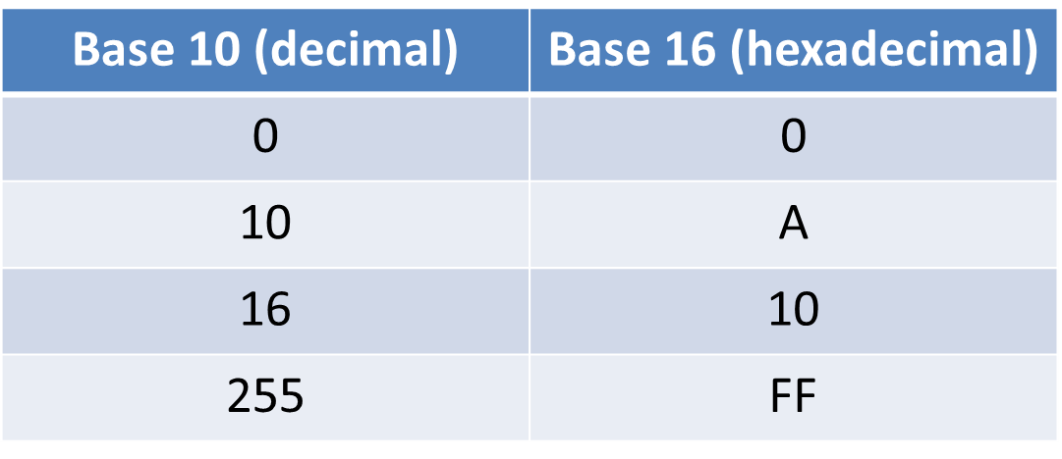
Colors
Option 3 – Hexadecimal
Hexadecimal expresses single digits numbers 0-9, A, B, C, D, E, F. These numbers would be equivalent to decimal numbers 0-15 (with F being equal to 15)
To represent the values 0-255, two hexadecimal digits are needed

Slide 50
Colors
Option 3 – hexadecimal
To convert from decimal to hex, divide decimal number by 16. Quotient (expressed in hex) is left digit, remainder (expressed in hex) is right digit
175₁₀ = 175/16 = 10 r 15 = AF₁₆
219₁₀ = 219/16 = 13 r 11 = DB₁₆
To convert from hex to decimal, convert left digit to decimal and multiply by 16, add to that the right digit converted to decimal
BC₁₆ = 11*16 +12 = 188₁₀
AA₁₆ = 10*16 + 10 = 176₁₀
Or, just use a
Scientific calculator

Slide 51

Colors
Option 3 – hexadecimal
Black #000000
White #FFFFFF
Red #FF0000
Green #00FF00
Blue #0000FF
BlanchedAlmond #FFEBCD
DeepSkyBlue #00BFFF
GreenYellow #ADFF2F

Slide 52
Colors
Option 4 would be to express the RGBA values
Very similar to option 2, however this allows us to identify the opacity of the object by setting the Alpha parameter. This ranges from 0.0 (fully transparent) to 1.0 (fully opaque)
This is supported in IE9+, Firefox 3+, Chrome, Safari, Opera 10+
rgba(RED, GREEN, BLUE, ALPHA);
Example: color: rgba(255, 0, 0, 0.3); /* red with opacity */

Slide 53
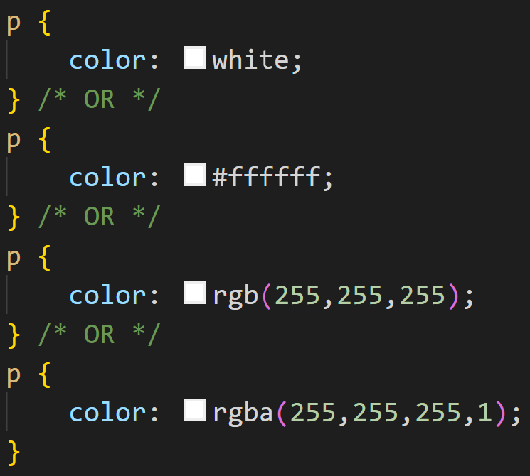
Colors
So to change the font color of a paragraph to white we could do one of the following:

Slide 54

Questions?

Slide 55
Lecture Quiz
1. Which of the following is not a valid class or id name?
contentTwo
_content
Content2
$content

Slide 56
Lecture Quiz
2. What color is this: #00FF00?

Slide 57
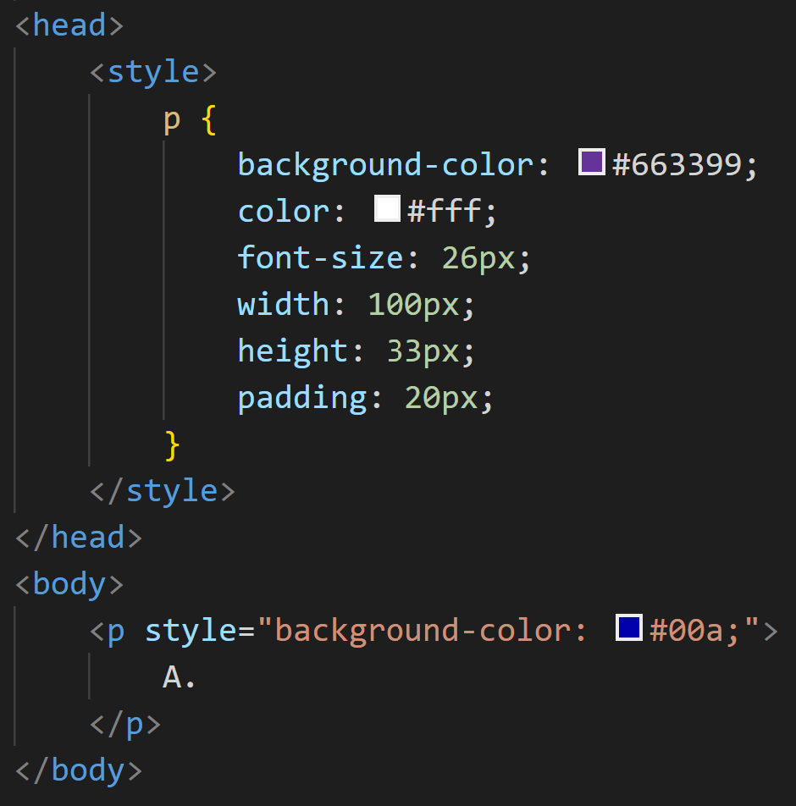




Lecture Quiz
3. Given the following code, what is the background color of the paragraph?

Slide 58
Lecture Quiz
4. What CSS property would we use to modify the display size of text?
font-size
text-size
size-font
text-points

Slide 59
Lecture Quiz
5. There is a strong relationship between user experience and layout?
True
False

Slide 60
Lecture Quiz
6. Which is the correct way to assign multiple classes to an element?
<p class="md high-contrast centered">
<p class="md, high-contrast, centered">
<p class="md + high-contrast + centered">
<p class="md/high-contrast/centered">

Slide 61
Lecture Quiz
7. Which of the following correctly shows how to create a class in CSS?
.image { }
p.image { }
div.image { }
All of the above are correct

Slide 62
Lecture Quiz
8. What is the current, “official” version of CSS?
1
2
2.1
3
4

Slide 63
Lecture Quiz
9. What color is this: rgb(255,0,0)?

Slide 64
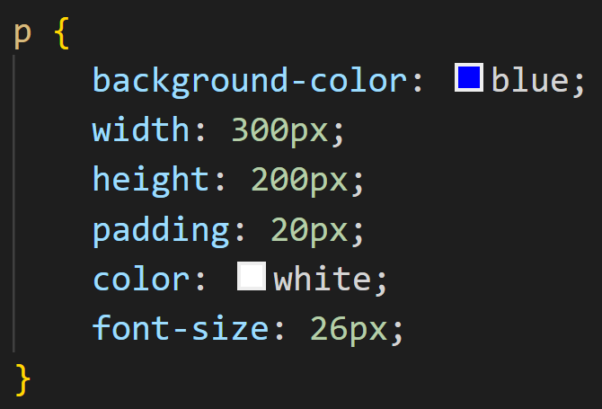
Lecture Quiz
10. Given the following CSS rule, which is a selector?
p
{ }
width
300px
;

Slide 65
Sources
“CSS Legal Color Values”, W3Schools, Retrieved from http://www.w3schools.com/cssref/css_colors_legal.asp
“HTML Color Names”, W3Schools, Retrieved from http://www.w3schools.com/html/html_colornames.asp
“HTML Reference”, W3Schools, Retrieved from http://www.w3schools.com/tags/default.asp
“HTML Reference”, W3Schools, Retrieved from http://www.w3schools.com/tags/default.asp
“HTML Symbols”, W3Schools, Retrieved from http://www.w3schools.com/html/html_symbols.asp
Kooser, A. “3 percent of American adults still cling to dial-up Internet”, W3Schools, August 2013, Retrieved From http://www.cnet.com/news/3-percent-of-american-adults-still-cling-to-dial-up-internet/
Duckett, J. (2011). HTML & CSS: Design and build websites. Indianapolis,IN: John Wiley & Sons.

